Slide 1
Formula 1 Tracker- CSE 111 Team 24
By: Manjot Singh, Alan Triano
Notes:
Good evening, this is our CSE 111 Project. My name is Alan Triano, and my name is Manjot Singh. We have devised a project that will track the entities involved in a Formula 1 race weekend.

Slide 2
Project Description
Big Idea: Have a database to track the actions of employers and employees, the events, and the standings of a Formula 1 race weekend, depending on who’s signed in.
Spectators will be able to view the race weekend’s results, and the overall standings of each driver and team.
Employers will be able to view their Employees and assign them tasks to do over the weekend.
Employees (including Marshals and Stewards) will be able to view the tasks assigned to them by their Employers
Teams, in addition to viewing Employees will also be able to view their team’s own standings, their drivers and their driver’s standings and finishing positions for the weekend
Stewards will update the results of the weekend and manage them.
Notes:
So, our project’s main goal was to have a database that tracks the actions of employers and employees, the events, and the standings of a Formula 1 race weekend.
Spectators signed into the database will be able to view the race weekend’s results, and the overall standings of each driver and team.
Employers will be able to view the Employees they’ve employed and assign them tasks to do over the weekend
Employees, including the marshals and stewards at the event will be able to view the tasks assigned to them by their Employers.
Teams, as a subclass of employers will be able to view and assign tasks to employees, will be able to view their team’s own standings, their drivers, and their driver’s standings and finishing positions
Stewards, in addition to being managed by the governing body (itself an employer) can update the results of the weekend and manage them.

Slide 3



Implementation Approach
IDE
Android Studio
Database
SQLite3
Language
Java
Notes:
We both have experience with Android Studio so we will be using that as our approach instead of going for a web based application. We will also be using Java but may experiment with Kotlin if needed, as both are supported by Android Studio. The database language and setup will all be done in SQLite3.

Slide 4
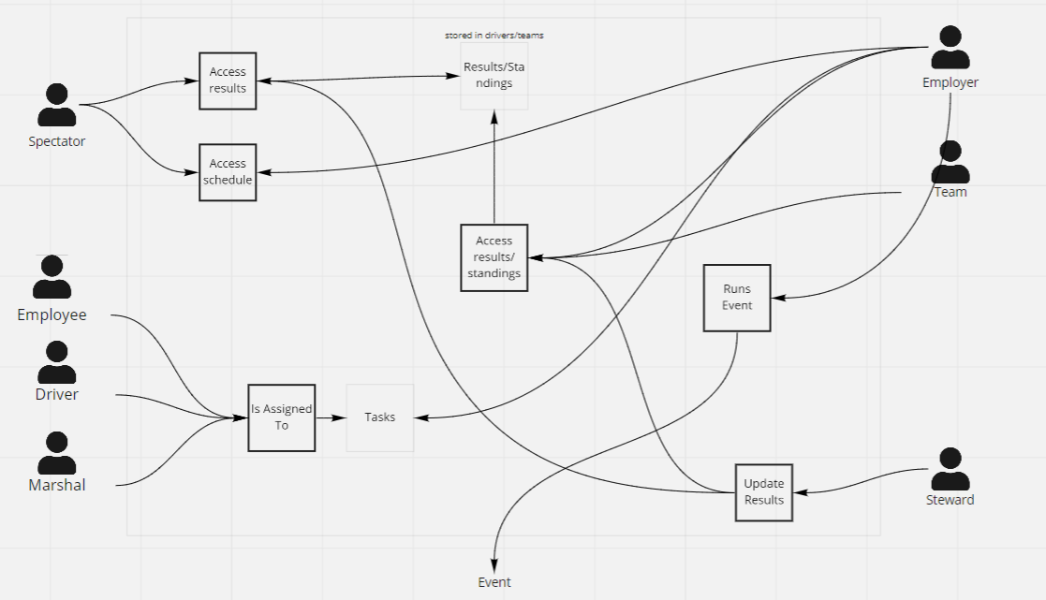
Use Case Diagram
Notes:
We have 7 different entities.
Spectator is the general viewer who has access to the schedule of the races and the results after they have completed, from both drivers and teams.
Employees, the ones who operate on the track and off the track doing miscellaneous activities, Drivers, the ones driving the vehicle in the races, and Marshals, the volunteers that manage the race and clear the racetrack of debris who all get assigned tasks from multiple employers.
The employers are in charge of managing security, food distribution, ordering of marshals and stewards, to run their specific events.
Events are its own entity in which many employers run as part of the race weekend (be that the actual race, concerts, VIP events, press conferences, etcetera.)
The team manages the drivers and their specific employees, but also have their own standings, as the sum of their drivers’ placements are also tracked.
Lastly, the steward referees the race, assigns points/penalties as needed and also updates final standings/results that are stored in drivers/teams relations

Slide 5
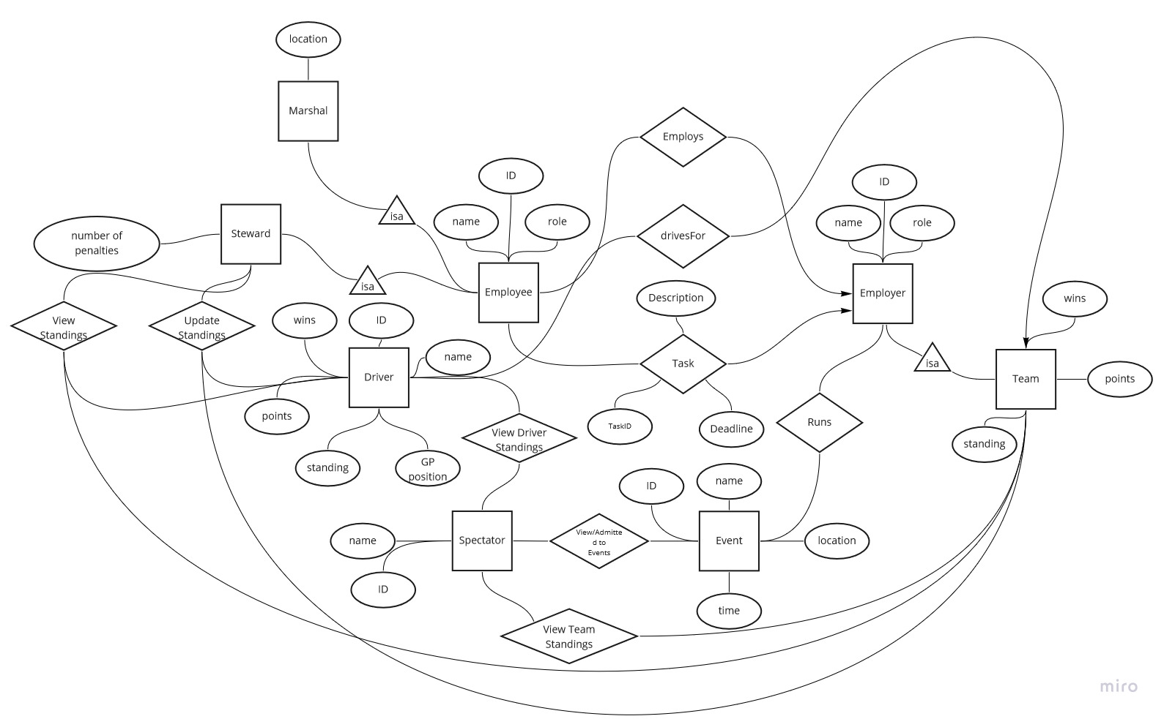
Entity/Relationship Diagram
Notes:
So here we have our UML Use Case Diagram represented as an Entity Relation Diagram
Spectators have multiple options. They can both view the drivers and team standings separately in the View Standings and View Team Standings. They also have a relationship to Events which allows them to view and register for Events.
Events is a separate entity describing the list of side events that occur during the weekend. They are both attended by Spectators in a Many-Many relationship, and run by Employers in a Many/Many relationship
Employers are the organizations involved in the event with their own roles. They employ employees in a many to one relation (all employees can be employed for 1 company). Connected to that is another relation Task, which serves to track the tasks done by their employees, and it is also many-one (all employes can do tasks for 1 company). Team is a subtype of Employers which directly competes in the race, and has its own attributes tracking their position in the championship.
Employee is an entity which is employed by an Employer in a many-one relationship, tracking their ID, name, and role. They are the people employed to handle the events being run (or teams that compete). From Employee, we have two separate subtypes, Steward and Marshal which have more to do with the running of our main event. Marshals are the volunteers on track who handle incident cleanups as well as the waving of flags (which will be tracked in the Task relation). We’ll also have (in addition to Employee’s attributes) their physical location on track. Stewards are like the referees, and manage the enforcement of rules during the race (and be tasked to do certain things like attend a meeting). In addition to Employee’s attributes, we’ll track their number of penalties. They will have a separate many-many relationship of View and Update Standings which will log the views and updates each steward makes to the standings in accordance with rule enforcement.
Driver is its own entity. It’s somewhat similar to Team in that we track their position, points, and wins in their standings (Team and Driver Championships are kept separate). They have a relation drivesFor with team which is many to one (all drivers drive for 1 team).

Slide 6
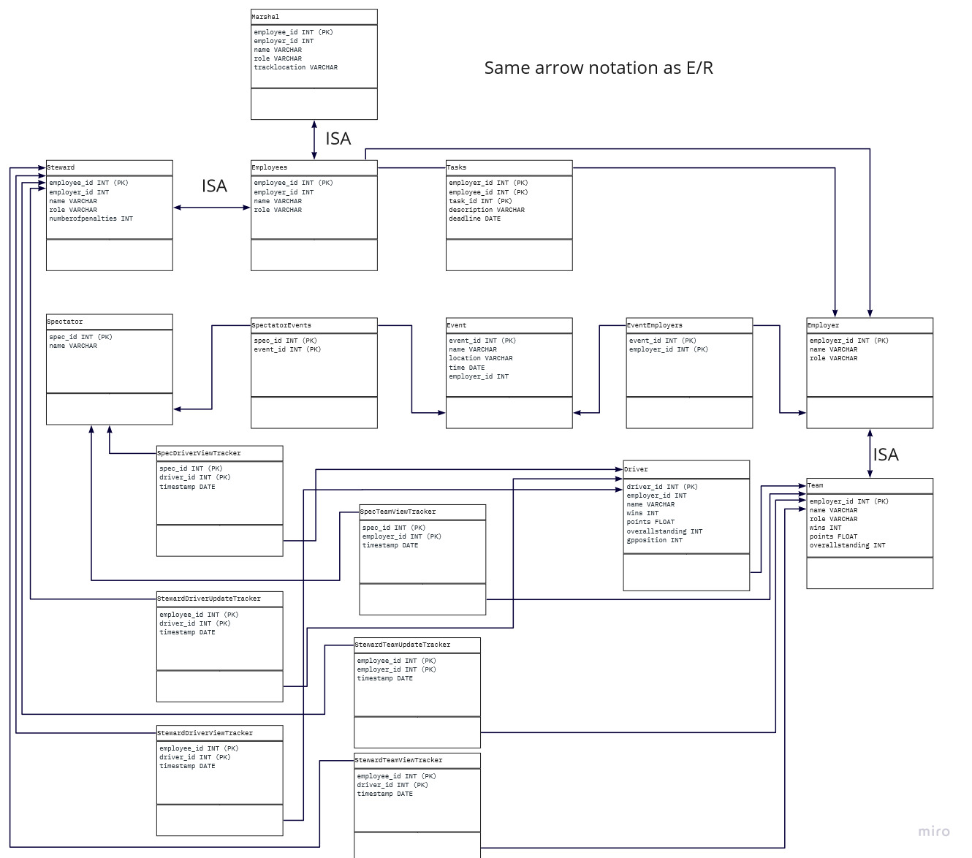
Relational Schema
Notes:
So here is our Entity-Relation Diagram mapped to a Relational Schema. Our schema is very similar to our Entity-Relation diagram with some changes. We are using a tracker representing our view and update requests for Spectator and Steward towards the Teams and Drivers (whenever they access the standings/results, and in the case of Steward, modify them). This is to represent our many-many relationship on our Entity-Relation Diagram. We are using the tracker entity to track accesses to the driver and team standings, as well as track each time a steward updates the team and driver standings.

